Slide 1
LG M48F Supply Plan and Metals Dashboards Overview
Chiemi Kato
December 2019

Slide 2
Introduction
LG M48F Supply Plan
Metals Dashboards
LG Chem signed a contract to produce batteries for Tesla products at GF3 in late 2018.
Our team started working with LG Chem on this project ____
Challenges:
No framework for communication or operational analysis between Tesla and LG
We weren’t exactly sure how our vehicle production and sale would be impacted by LG’s production capacity
Sarah was using an excel-based dashboard that came with a long list of constraints
She asked for a transition to Power BI interface, which would allow for interactive dashboards
Challenges:
Time inefficient
Not all the way functional tool

Slide 3
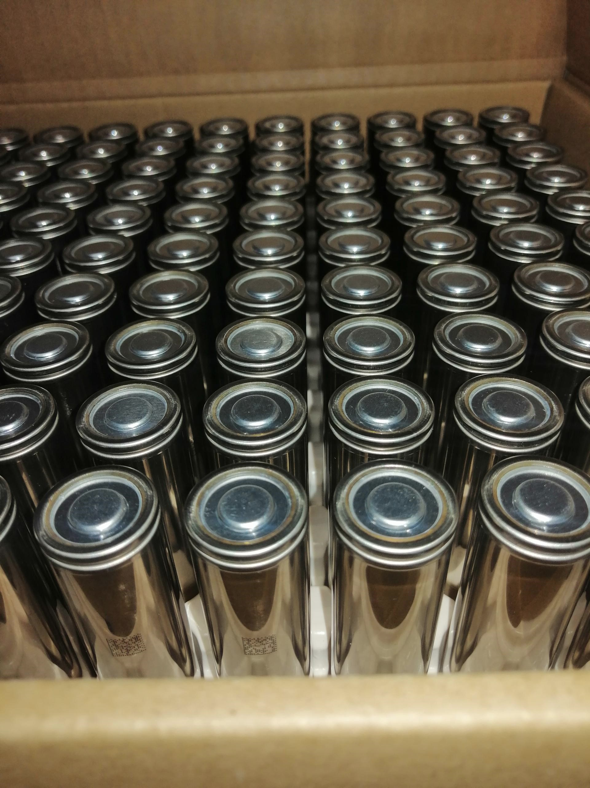
LG M48F Supply Plan Process/Improvements
Integrated information from finance to provide different demand-side scenarios
Set up a framework for LG to be able to provide more details (ie weekly production data and separated by assembly line)
Created scenario options/toggles to simulate and identify how the supply will be impacted by design changes

Slide 4
Demo

Slide 5
Outcome/Final Benefits
There is now a detailed framework and unified platform for teams to simulate and evaluate their own ideas
Improves interdepartmental and inter-company communication and understanding

Slide 6

Metals Dashboards Process/Improvements
- Restructured the way source files were stored (SQLite database) so that visualizations would not be disrupted with data updates
- Used python to automate the data cleaning and transformations before loading to Power BI
- Utilized SharePoint/Power BI integration by hosting the visualizations in SharePoint Battery GSM page

Slide 7
Metals Dashboards Process/Improvements
Before | After

Slide 8
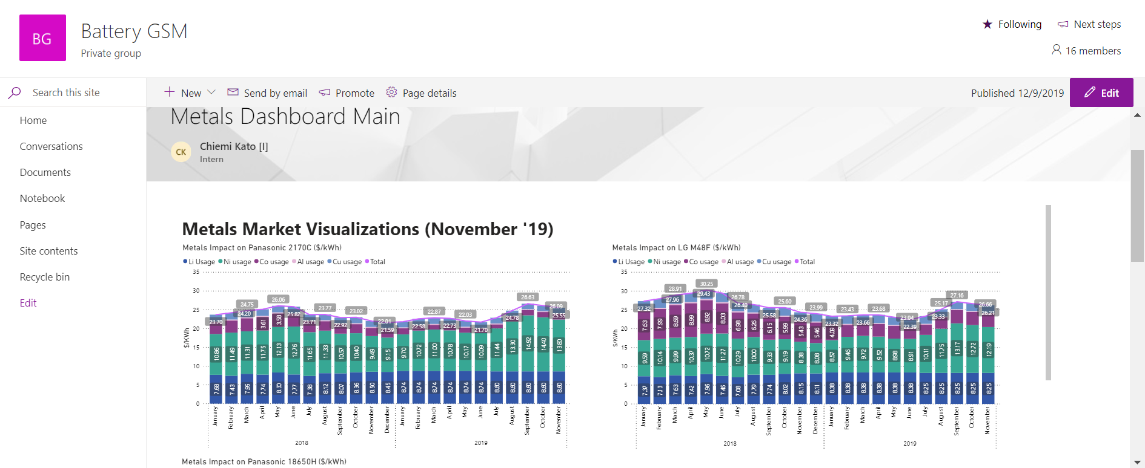
How to Access? (After your account is approved by Katie) go to SharePoint Battery GSM page and click “Pages” tab to the left.

Slide 9
Demo

Slide 10
Outcome/Final Benefits
Via seamless Power BI/SharePoint integration, there is more room for collaboration with cloud-based editing tools
All of the data automation is done within OneDrive cloud so that it can be completed by other team members
The interactive functionality of the Power BI dashboards allow for a deeper dive into the details
Increased time efficiency

Slide 11
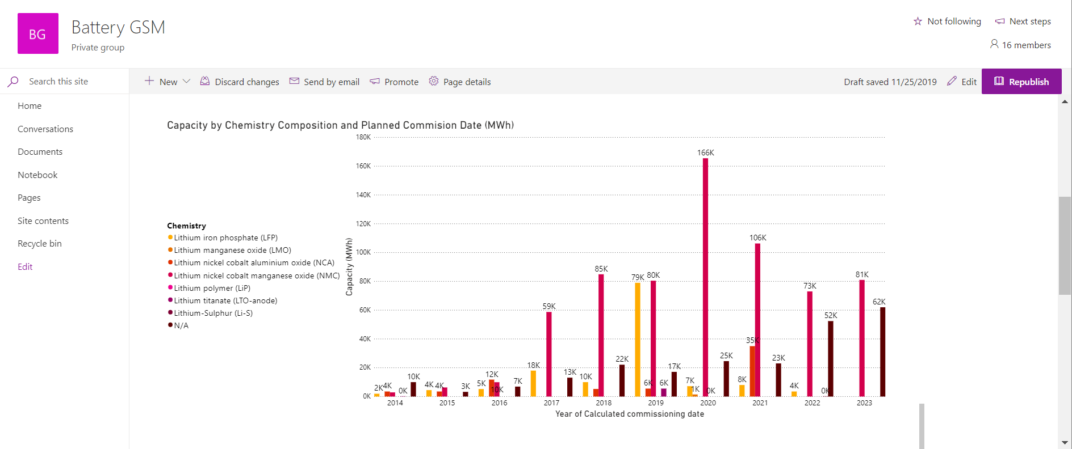
THE END
Check it out!

